Slide 1
String Handling in Java
How to create String object?
There are two ways to create String object: By string literal By new keyword

Slide 2
String literal
String s="Hello";
Each time you create a string literal, the JVM checks the string constant pool first. If the string already exists in the pool, a reference to the pooled instance returns. If the string does not exist in the pool, a new String object instantiates, then is placed in the pool. For example: String s1="Welcome"; String s2="Welcome";//no new object will be created

Slide 3
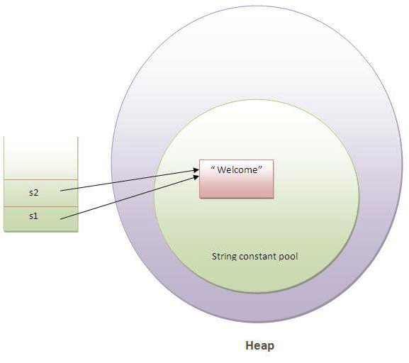
Note: String objects are stored in a special memory area known as string constant pool inside the Heap memory.
Why java uses concept of string literal?
To make Java more memory efficient (because no new objects are created if it exists already in string constant pool).

Slide 4
2) By new keyword
String s=new String("Welcome");
//creates two objects and one reference variable
In such case, JVM will create a new String object in normal(nonpool) Heap memory and the literal "Welcome" will be placed in the string constant pool.
The variable s will refer to the object in Heap (nonpool).

Slide 5
Immutable String in Java
In java, string objects are immutable. Immutable simply means unmodifiable or unchangeable.
Once string object is created its data or state can't be changed but a new string object is created.
class Simple
{
public static void main(String args[]){
String s="Sachin";
s.concat(" Tendulkar");
//concat() method appends the string at the end
System.out.println(s);
//will print Sachin because strings are immutable objects
}
}
Output: Sachin

Slide 6
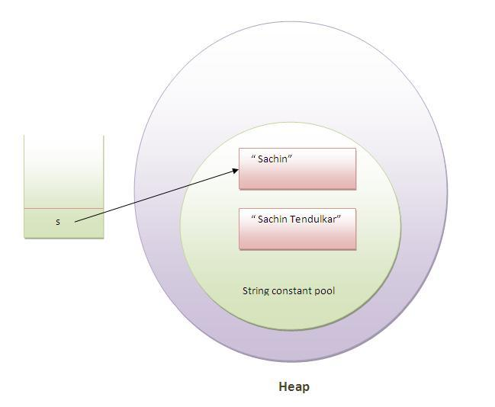

Slide 7
Mutable Strings in Java
In mutable string the value is changed in the address itself
StringBuffer class is used for creating mutable string
class A
{
public static void main(String args[])
{
StringBuffer sb=new StringBuffer("Hello ");
sb.append("Java"); //now original string is changed
System.out.println(sb); //prints Hello Java
}
}

Slide 8
String comparison in Java
There are three ways to compare String objects:
By equals() method
By = = operator
By compareTo() method
1) By equals() method
public boolean equals(Object another){} compares this string to the specified object.
public boolean equalsIgnoreCase(String another){} compares this String to another String, ignoring case.

Slide 9
class Simple
{
public static void main(String args[]){
String s1="Sachin";
String s2="Sachin";
String s3=new String("Sachin");
String s4="Saurav";
System.out.println(s1.equals(s2));//true
System.out.println(s1.equals(s3));//true
System.out.println(s1.equals(s4));//false
}
}

Slide 10
//Example of equalsIgnoreCase(String) method
class Simple{
public static void main(String args[]){
String s1="Sachin";
String s2="SACHIN";
System.out.println(s1.equals(s2));//false
System.out.println(s1.equalsIgnoreCase(s3));//true
}
}

Slide 11
2) By == operator
class Simple{
public static void main(String args[]){
String s1="Sachin";
String s2="Sachin";
String s3=new String("Sachin");
System.out.println(s1==s2);//true (because both refer to same instance)
System.out.println(s1==s3);//false(because s3 refers to instance created in nonpool)
}
}
The = = operator compares references not values.

Slide 12
3) By compareTo() method:
compareTo() method compares values and returns an int which tells if the values compare less than, equal, or greater than.
Suppose s1 and s2 are two string variables.If:
s1 == s2 :0 s1 > s2 :positive value s1 < s2 :negative value

Slide 13
class Simple
{
public static void main(String args[])
{
String s1="Sachin";
String s2="Sachin";
String s3="Ratan";
System.out.println(s1.compareTo(s2));//0
System.out.println(s1.compareTo(s3));//1(because s1>s3)
System.out.println(s3.compareTo(s1));//-1(because s3 < s1 )
}
}

Slide 14
String Concatenation in Java
There are two ways to concat string objects:
By + (string concatenation) operator
By concat() method

Slide 15
1) By + (string concatenation) operator
class Simple{
public static void main(String args[]){
String s="Sachin"+" Tendulkar";
System.out.println(s);//Sachin Tendulkar
}
}
The compiler transforms this to:
String s=(new StringBuilder()).append("Sachin").append(" Tendulkar).toString();
String concatenation is implemented through the StringBuilder(or StringBuffer) class and its append method.
String concatenation operator produces a new string by appending the second operand onto the end of the first operand.

Slide 16
2) By concat() method
class Simple{
public static void main(String args[])
{
String s1="Sachin ";
String s2="Tendulkar";
String s3=s1.concat(s2);
System.out.println(s3);//Sachin Tendulkar
}
}

Slide 17
Substring in Java
public String substring(int startIndex):
This method returns new String object containing the substring of the given string from specified startIndex (inclusive).
public String substring(int startIndex,int endIndex):
This method returns new String object containing the substring of the given string from specified startIndex to endIndex.

Slide 18
Example of java substring
class Simple
{
public static void main(String args[])
{
String s="Sachin Tendulkar";
System.out.println(s.substring(7));//Tendulkar
System.out.println(s.substring(0,6));//Sachin
}
}

Slide 19
Methods of String class | Description
1)public boolean equals(Object anObject) | Compares this string to the specified object.
2)public boolean equalsIgnoreCase(String another) | Compares this String to another String, ignoring case.
3)public String concat(String str) | Concatenates the specified string to the end of this string.
4)public int compareTo(String str) | Compares two strings and returns int
5)public int compareToIgnoreCase(String str) | Compares two strings, ignoring case differences.
6)public String substring(int beginIndex) | Returns a new string that is a substring of this string.
7)public String substring(int beginIndex,int endIndex) | Returns a new string that is a substring of this string.
8)public String toUpperCase() | Converts all of the characters in this String to upper case
9)public String toLowerCase() | Converts all of the characters in this String to lower case.
10)public String trim() | Returns a copy of the string, with leading and trailing whitespace omitted.
11)public boolean startsWith(String prefix) | Tests if this string starts with the specified prefix.
12)public boolean endsWith(String suffix) | Tests if this string ends with the specified suffix.
13)public char charAt(int index) | Returns the char value at the specified index.
14)public int length() | Returns the length of this string.

Slide 20
Important Constructors of StringBuffer class
Constructor | Description
StringBuffer() | creates an empty string buffer with the initial capacity of 16.
StringBuffer(String str) | creates a string buffer with the specified string.
StringBuffer(int capacity) | creates an empty string buffer with the specified capacity as length.

Slide 21

Important methods of StringBuffer class
Modifier and Type | Method | Description
public synchronized StringBuffer | append(String s) | is used to append the specified string with this string. The append() method is overloaded like append(char), append(boolean), append(int), append(float), append(double) etc.
public synchronized StringBuffer | insert(int offset, String s) | is used to insert the specified string with this string at the specified position. The insert() method is overloaded like insert(int, char), insert(int, boolean), insert(int, int), insert(int, float), insert(int, double) etc.
public synchronized StringBuffer | replace(int startIndex, int endIndex, String str) | is used to replace the string from specified startIndex and endIndex.
public synchronized StringBuffer | delete(int startIndex, int endIndex) | is used to delete the string from specified startIndex and endIndex.
public synchronized StringBuffer | reverse() | is used to reverse the string.
public int | capacity() | is used to return the current capacity.
public void | ensureCapacity(int minimumCapacity) | is used to ensure the capacity at least equal to the given minimum.
public char | charAt(int index) | is used to return the character at the specified position.
public int | length() | is used to return the length of the string i.e. total number of characters.
public String | substring(int beginIndex) | is used to return the substring from the specified beginIndex.
public String | substring(int beginIndex, int endIndex) | is used to return the substring from the specified beginIndex and endIndex.

